Slide 1
United States and Canada
Mapping Activity

Slide 2
Use these maps to answer the tasks for this assignment
For each question, you will need to identify which map or maps you have used to complete the task
You will most likely need to use the Political Map for each question, so that is not a choice when you are selecting maps. If it happens to be the only map you use, you may add it to the list.

Slide 3
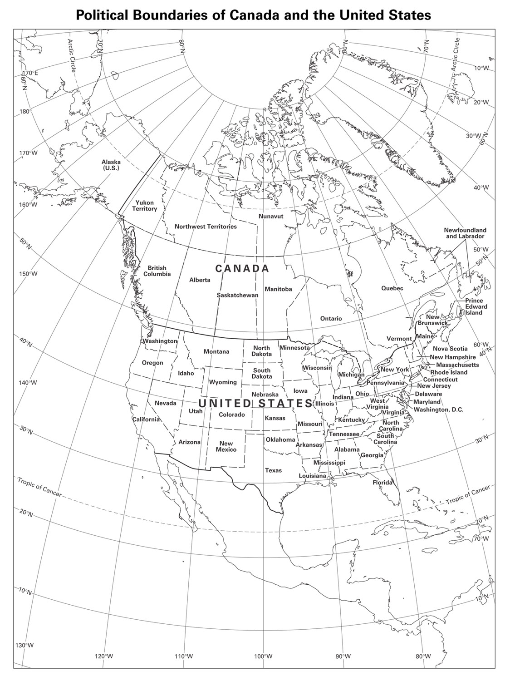
Political Map

Slide 4
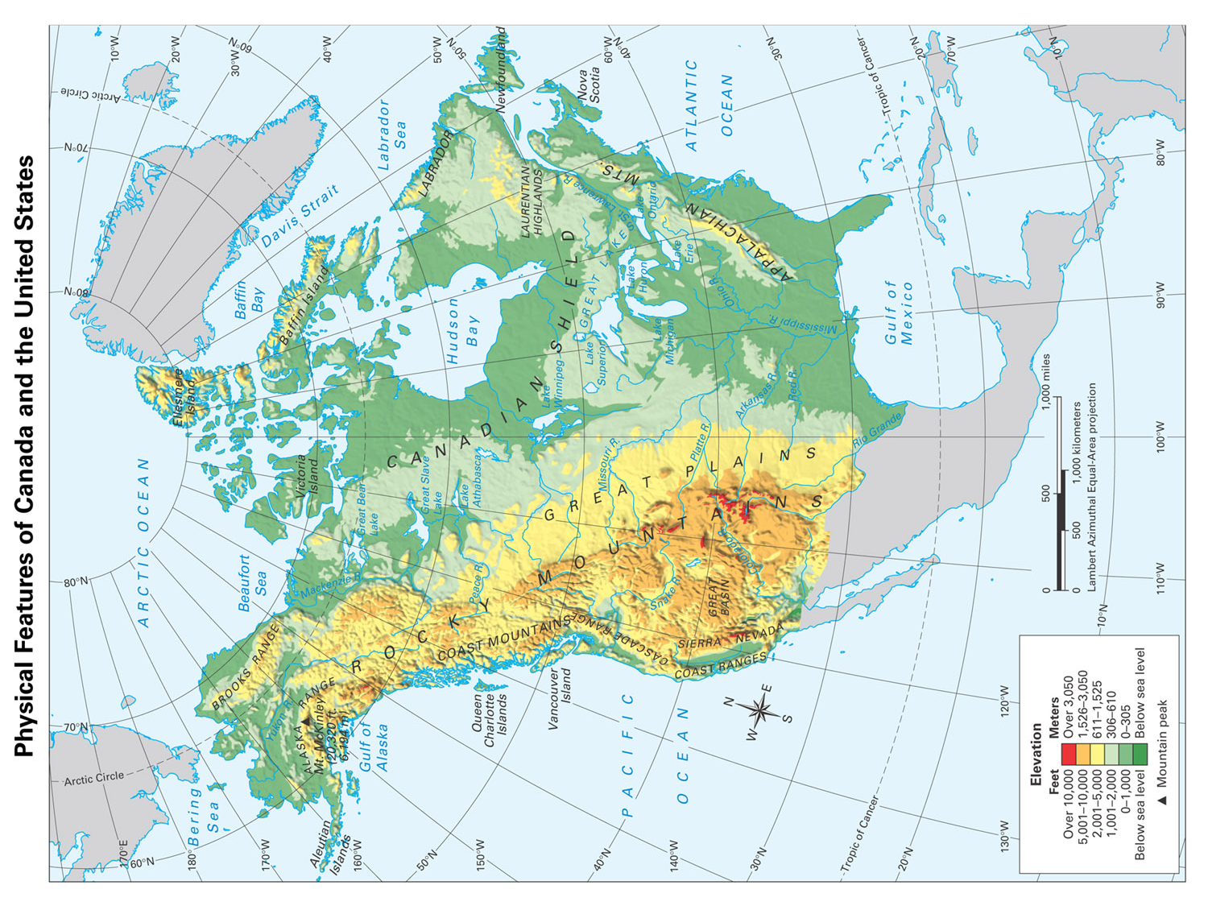
Physical Map

Slide 5
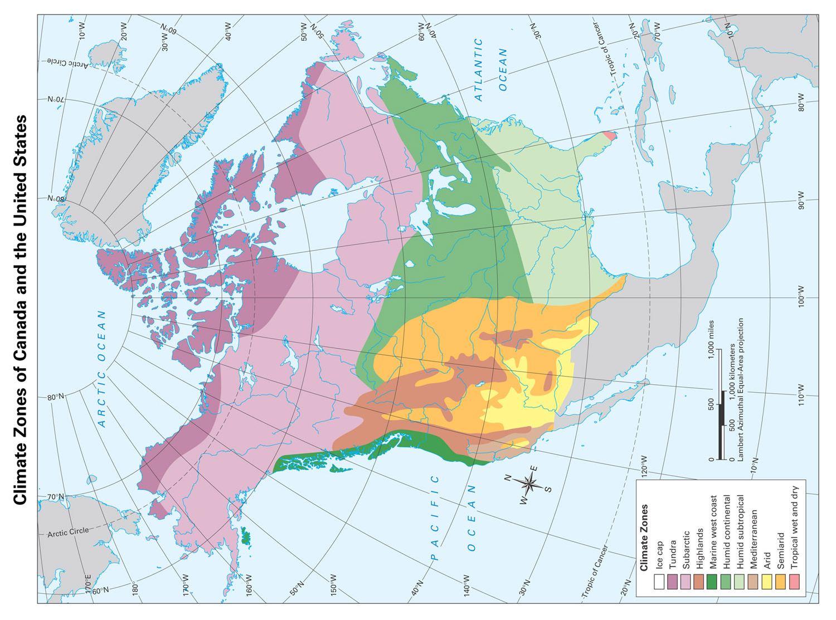
Climate Map

Slide 6
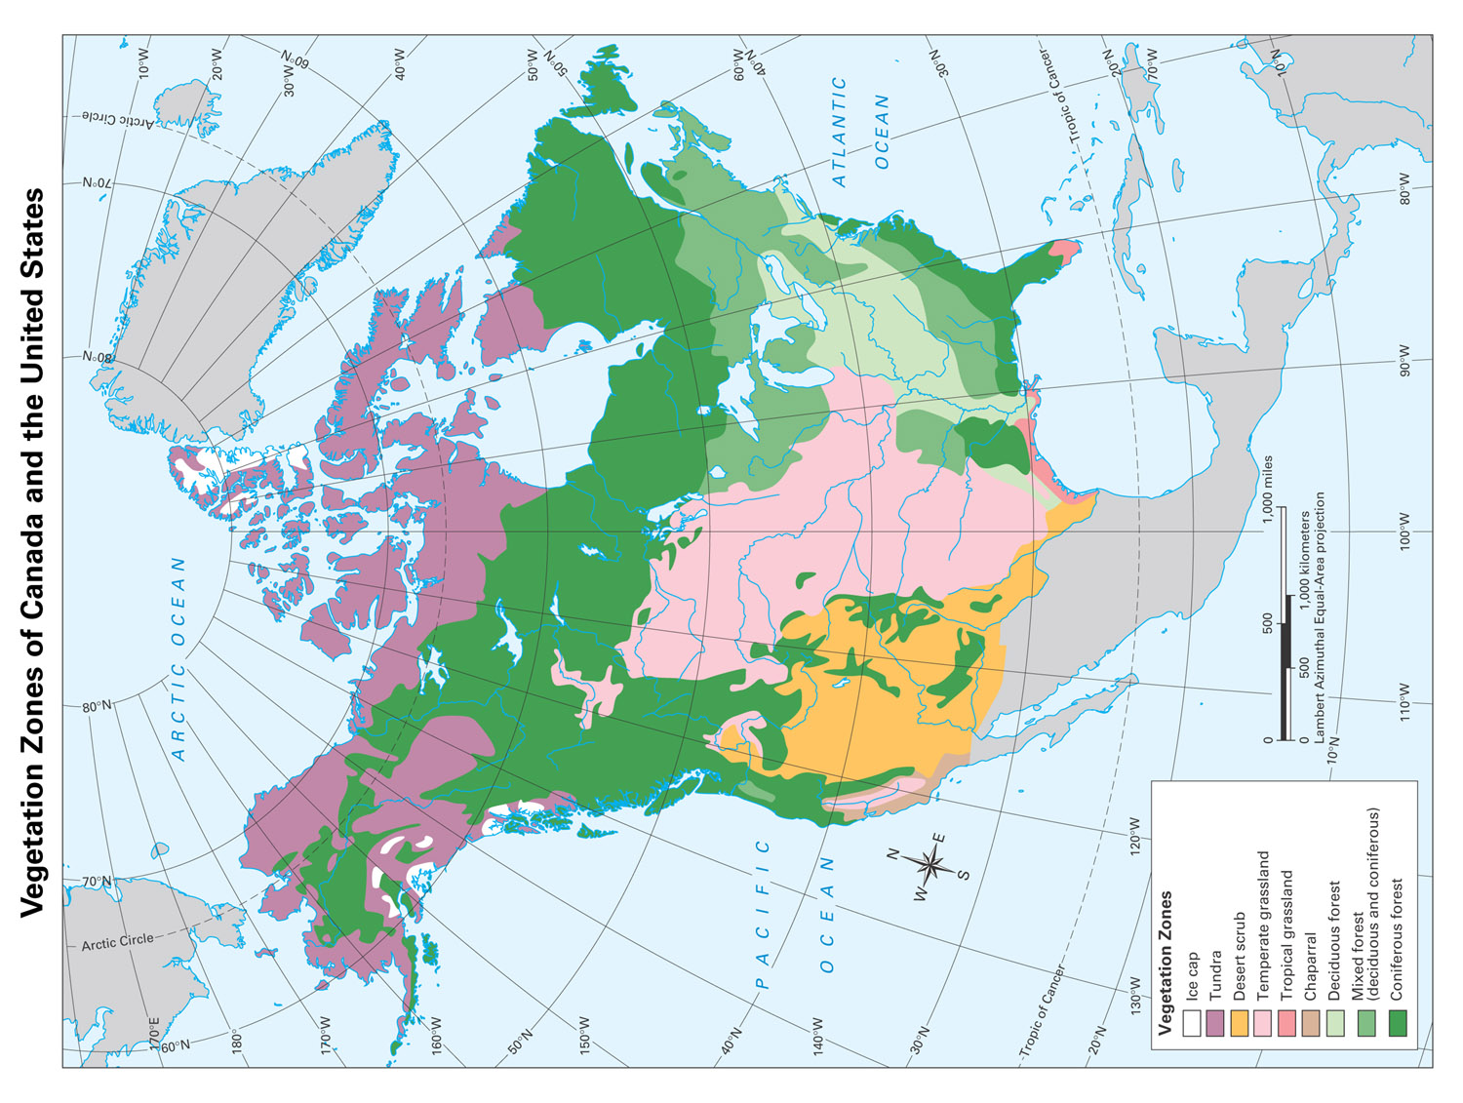
Vegetation Zones

Slide 7
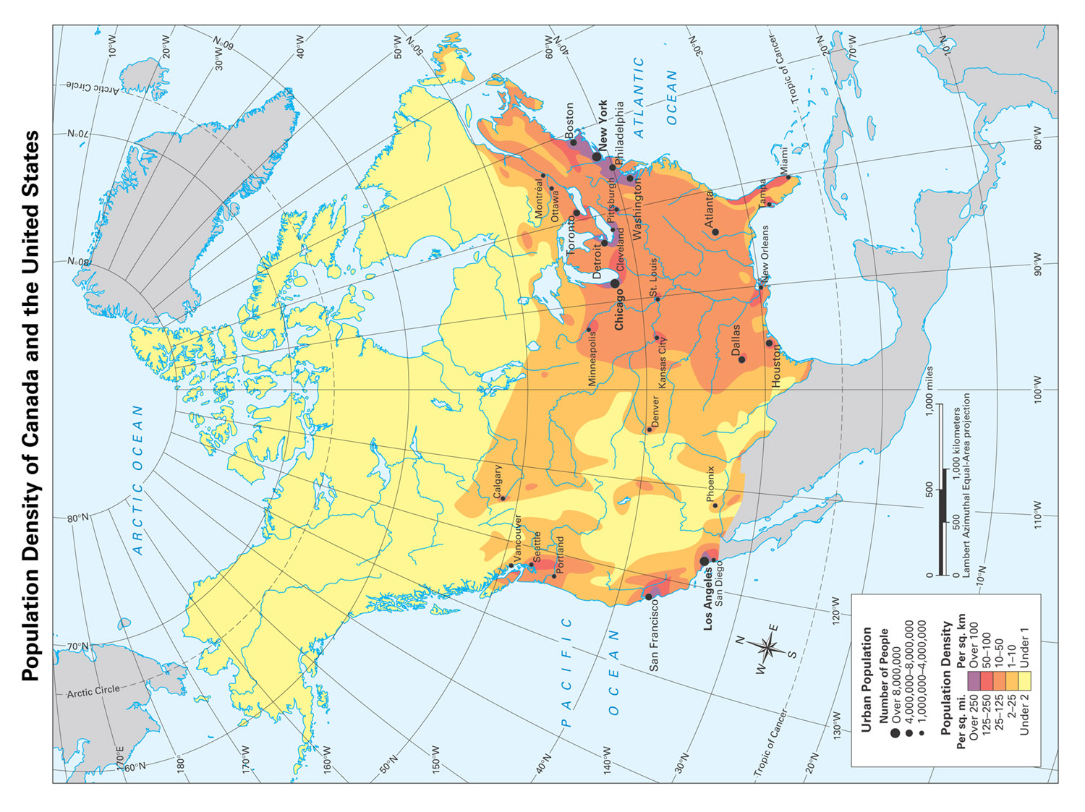
Population Density

Slide 8
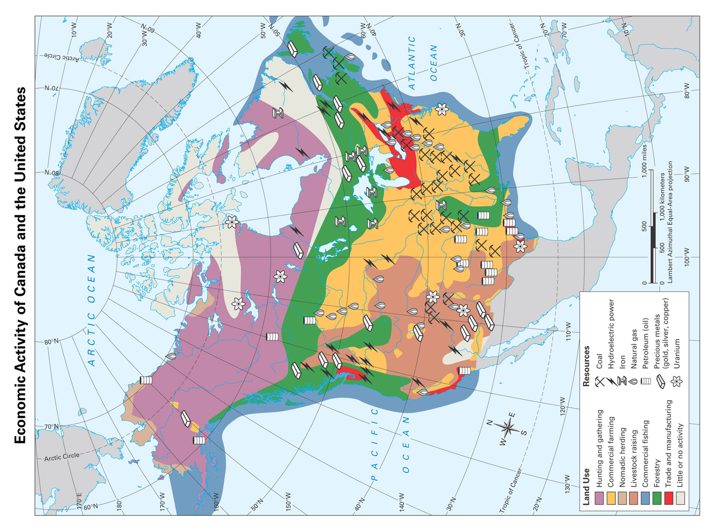
Economic Activity

